Slide 1
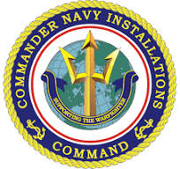
Navy Region Northwest
Casualty Assistance and Funeral Honors
CACO Training
Heidi Owens
Casualty Assistance Specialist
CACO Instructor 360-396-6880
heidi.m.owens2.civ@us.navy.mil
Lou Montoya
Program Director
360-340-0130
luis.e.montoya2.civ@us.navy.mil
Kelly Metzger
Casualty and Funeral Honors
360-315-3273
kelly.r.metzger.civ@us.navy.mil
Greg Patterson
Funeral Honors Specialist
360-315-3275
gregory.j.patterson7.civ@us.navy.mil
1100 Ramírez de Arellano Rd
Suite 113A
Silverdale, WA 98315-1100
Google NORTHWEST CACO
NWCasualty@us.navy.mil
Duty Cell 24x7 Flip Phone (360) 979-6786

Slide 2
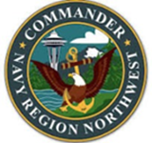
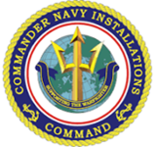
CACO Qualification
To qualify as a CACO, you must be:
An E7 or above with at least 2 years of active-duty service.
An E6 may qualify with the Commanding Officer’s (CO’s) permission.
Requirements for CACO Students
Obtain and review the CACO Student Manual and the PCR User Guide.
Register for the three Casualty Assistance trainings available in JKO (Joint Knowledge Online).
Attend CACO Training, which requires a minimum of 8 hours.
Complete the JKO trainings within 2 weeks after attending CACO Training.
Certification Process
Once you have sent your JKO certificates to Heidi, you will receive your CACO Certificate.

Slide 3
Casualty Assistance Program
Reference Overview:
REF 1: DoD Instruction 1300.18: Department of Defense Casualty Instruction.
REF 2: MILPERSMAN 1770 Series. PERS-00C owns the Navy’s Casualty policy
REF 3: CNICINST1770.2B - CNIC Mandates and funds the CACO Program.
REF 4: COMNAVREGNWINST1770.1F – Region works with CACOs and Commands.
Regions Across Navy Worldwide:
Train CACOs.
Assign CACOs.
Assist Next of Kin (NOK) via CACOs.
Support Commands via Command Representatives (CACO trained individual).

Slide 4
Casualty Process and Support
Commands: Initiates the casualty process with a Personal Casualty Report (PCR) per MILPERSMAN 1770-030 via DCIPS. Time: within 4 hours of being appraised of the death.
Regions: Act on PCR directions and assign CACOs.
CACOs: Work with regions to ensure NOK receive all benefits then turnover to Navy Gold Star.
Command Representatives: Collaborate with Region to fulfill Command responsibilities.
Case Duration: Two to Six weeks depending on the type of NOK being assisted.
Navy Gold Star: Takes over NOK care after all monetary benefits are provided.
Commands must report when members are diagnosed with a terminal illness or have been admitted to the hospital, example: Motorcycle Accident. These are SI or VSI cases.
Only ACDU deaths and DUSTWUN cases require a NOK notification via uniformed CACOs as directed by Region.

Slide 5
DD Form 1300 Report of Casualty

Slide 6
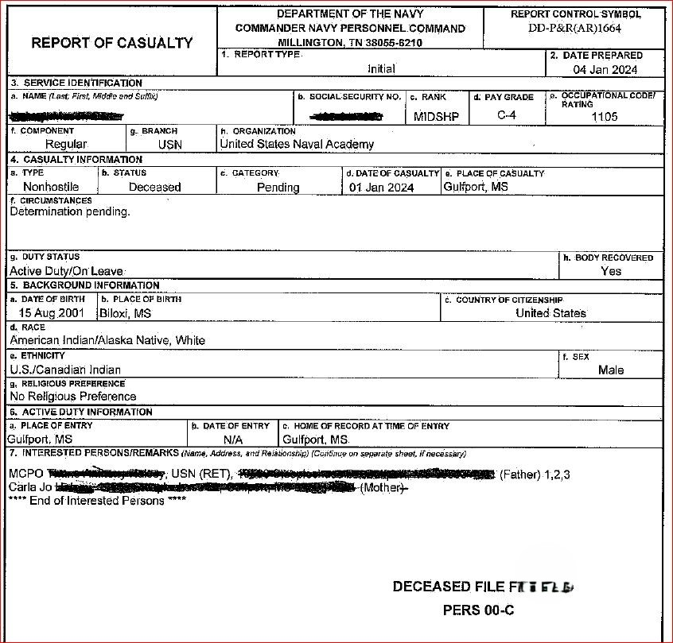

Slide 7
So…. Where do CACOs come from?
Parent Command
If the NOK Resides within 50 Miles from the Command
Naval Installations
Designated by Regional Commander to support NOK in their AOR

Slide 8
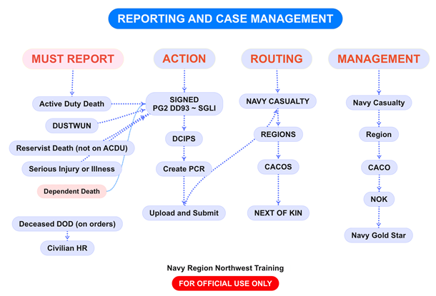

Slide 10
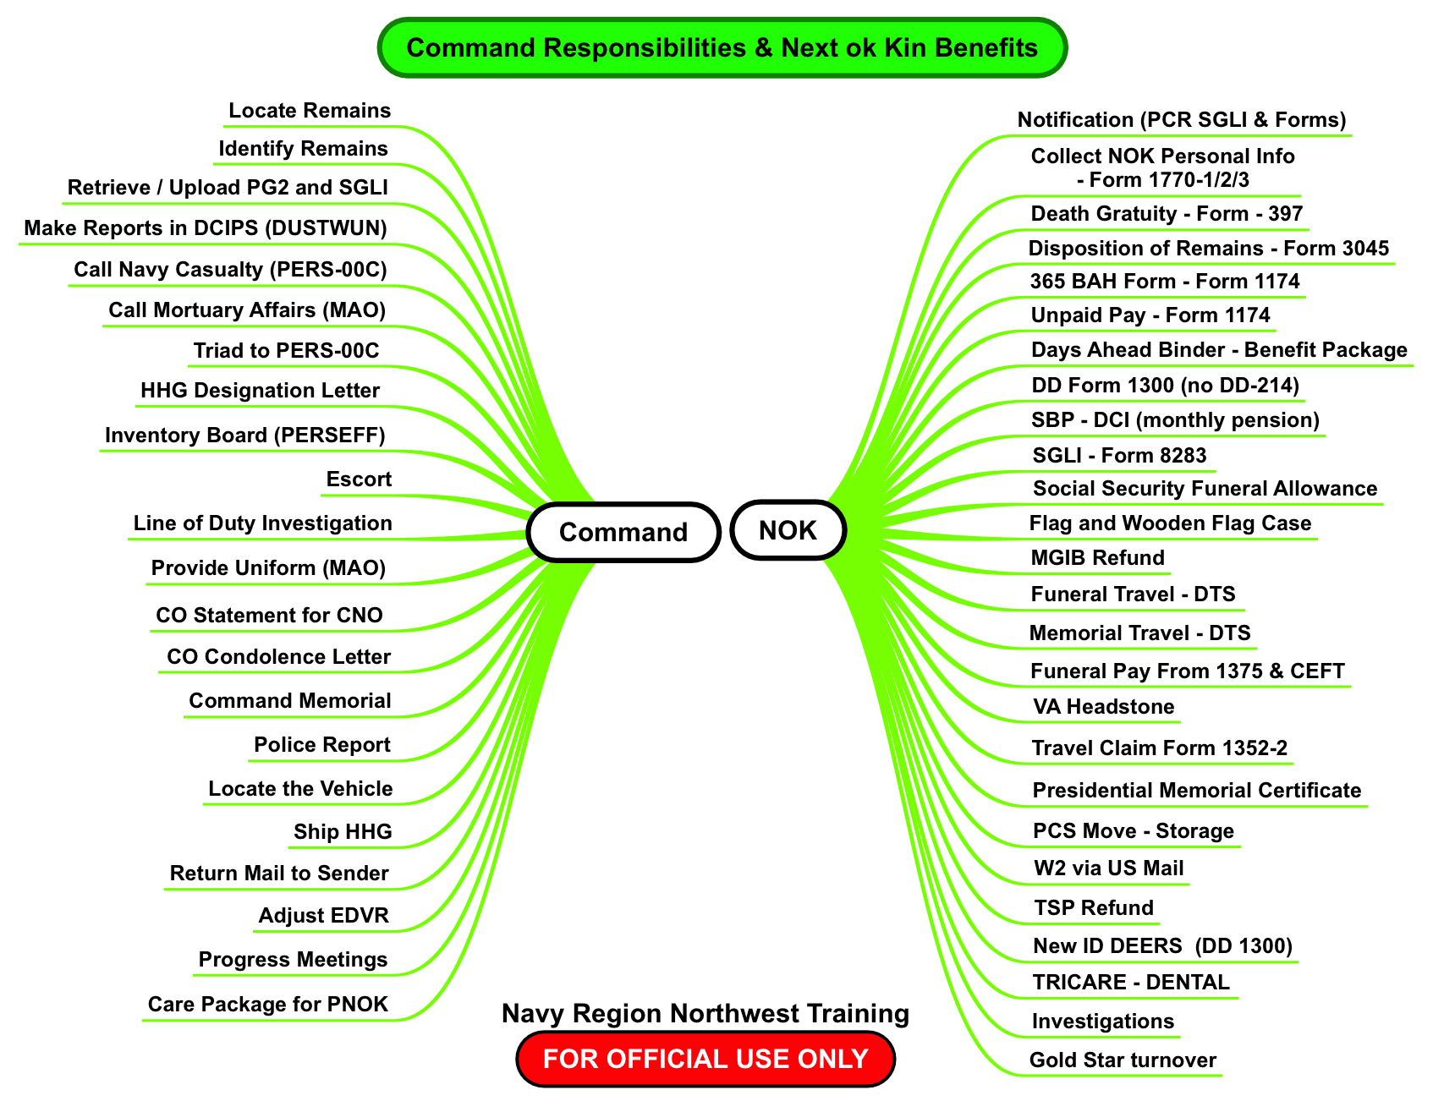

Slide 11
